Slide 1

American College Testing (ACT)
&
Scholastic Aptitude Test (SAT) Analysis
By Felicia Chua

Slide 2
Problem statement
With a change in the format of SAT in March 2016, this report aims to analyse SAT and ACT participation rate for 2017 and 2018 and how to improve the SAT participation rate.

Slide 3
Discoveries
Participation rate for SAT and ACT are inversely related
SAT participation rate improved from 2017 to 2018
Scores are also inversely proportional to participation rates
Some examples we will look at:
Florida maintain participation rate > 50% in both SAT and ACT.
Illinois switch from ACT to SAT as its participation rate changed drastically.
Ohio increased both SAT and ACT participation rate from 2017 to 2018.
Alaska low participation rate

Slide 4
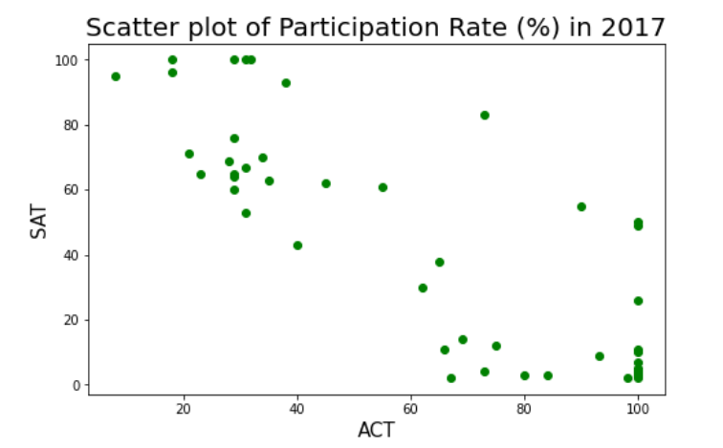
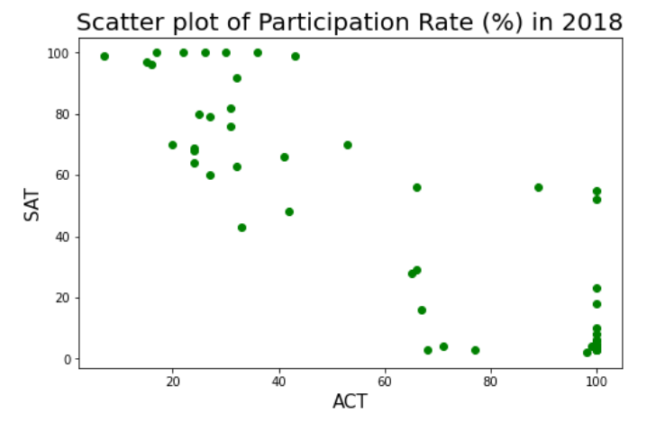
Florida
From the graph, states either choose to take SAT or ACT,
very few take both.
Central Florida allowed students to take the ACT or SAT during a typical school day with the cost borned by the school.
The state made it compulsory for students to partake in either the ACT or SAT examination if they want to enter Florida's state college.
Having it fully subsidized and given the choice to take either test resulted in high participation rates above 50% for both SAT and ACT.
SAT, ACT: Florida students lag behind national averages - Orlando Sentinel

Slide 5
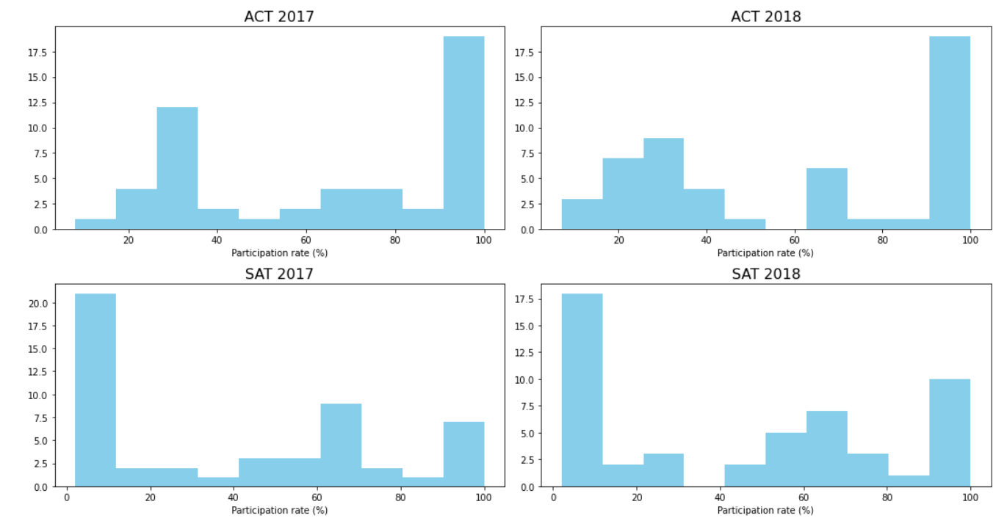

Slide 6
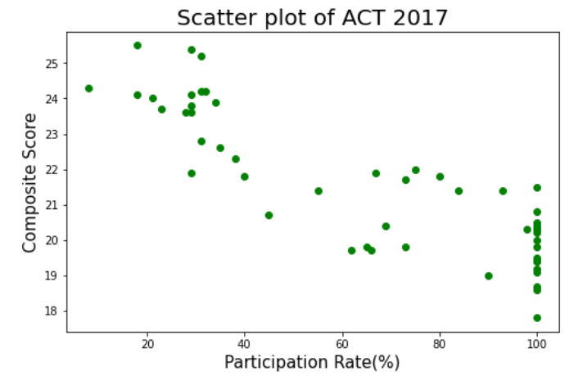
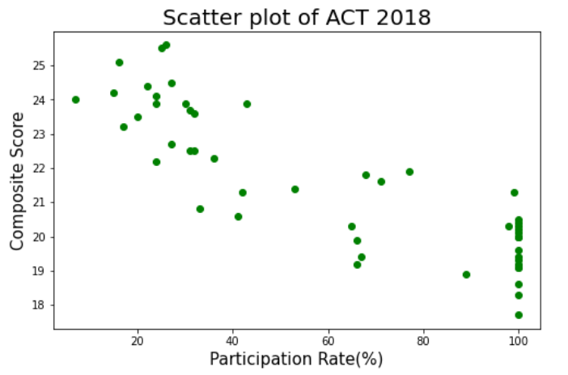
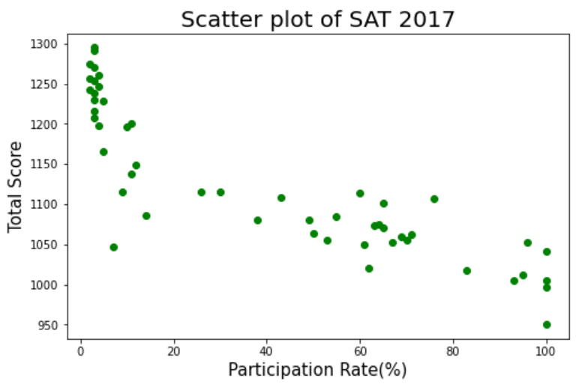
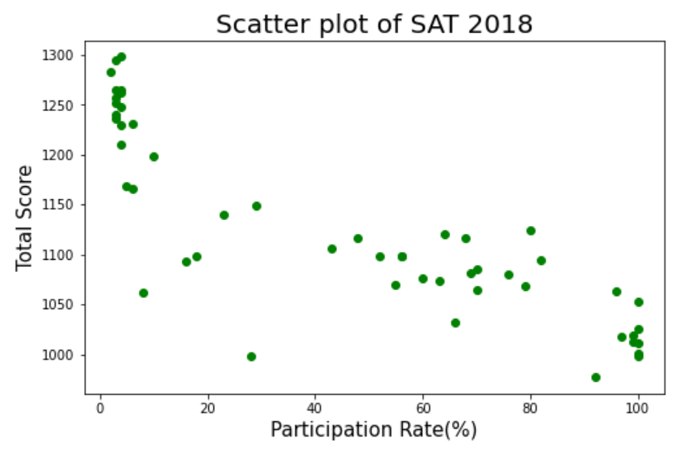
To prevent such patterns from happening, it is important to provide classes/mock test to students as we aim for a high participation rate.

Slide 7
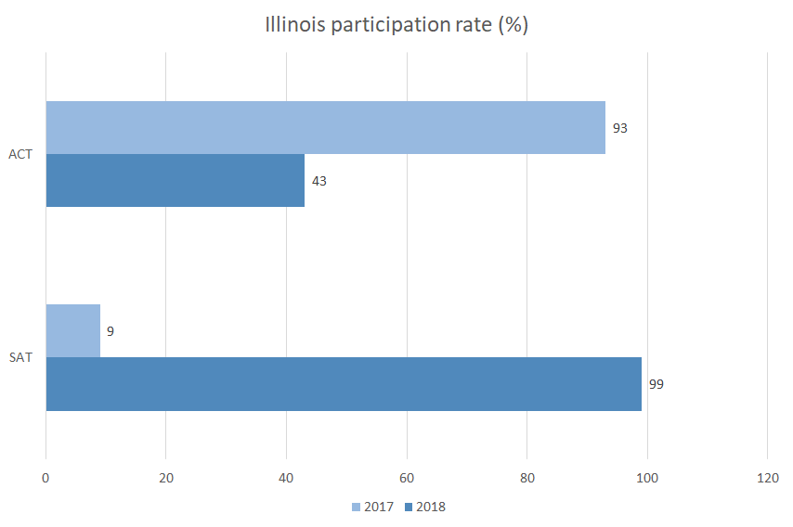
Illinois switched the compulsory test from ACT to SAT.
Hence, an increase in participation for SAT was observed together with a decrease in participation in ACT.
The Illinois State Board of Education (ISBE) reviewed both examinations and concluded that the SAT suits the learning outcome for students better.
Illinois moves ahead with new testing plan, replacing ACT with SAT - Chicago Tribune

Slide 8
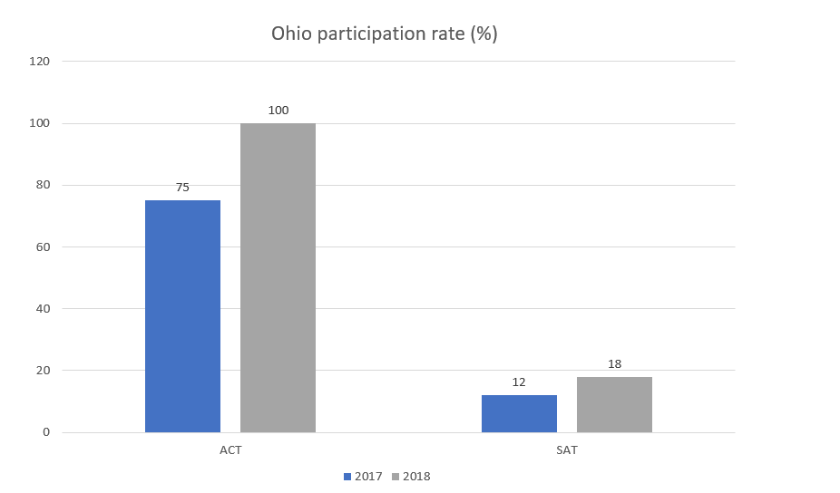
Ohio introduced the legislation for 11th graders to complete either the ACT or SAT.
This caused an increase in both the participation rate in SAT and ACT.
Furthermore, the state would sponsor every student for either test.
Ohio schools must now give ACT or SAT to all juniors - News - The Columbus Dispatch - Columbus, OH

Slide 9
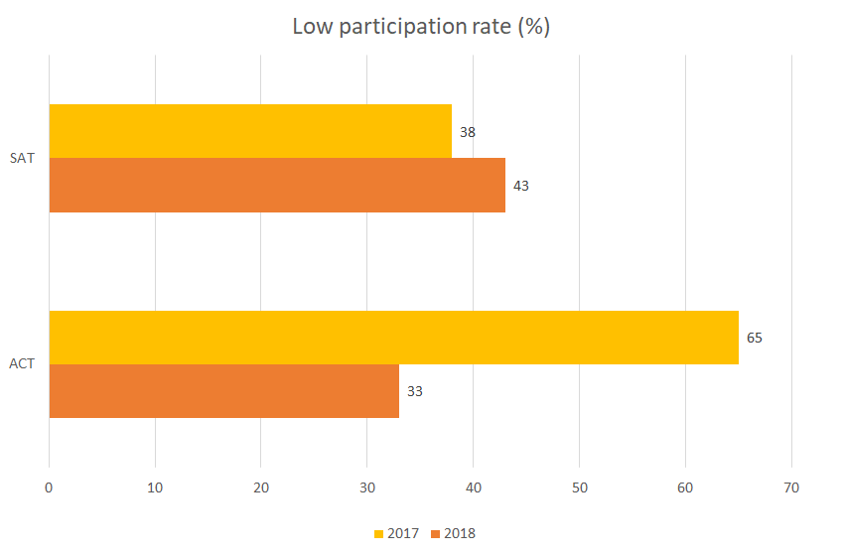
Alaska
Legislature in 2016 abolished the requirement of sitting for the SAT or ACT test.
Previously, students were funded by the state when they took the test. The intent was for students to concentrate on their high school curriculum. Without the encouragement from the state, participation rate naturally dwindled.
Alaska changes HS diploma requirements; no more SAT, ACT - Alaska Public Media
Alaska high school students no longer need national tests to graduate - Anchorage Daily News (adn.com)

Slide 10

Recommendations
College Board to:
List the benefits that SAT can improve students’ transitioning into the workplace.
Work with Alaska to provide more resources like meals and vouchers or subsidy so as to reduce the financial burden of students.
Equip students with materials to prepare them for the test (mock test/classes) either in school or online.

